Slide 1
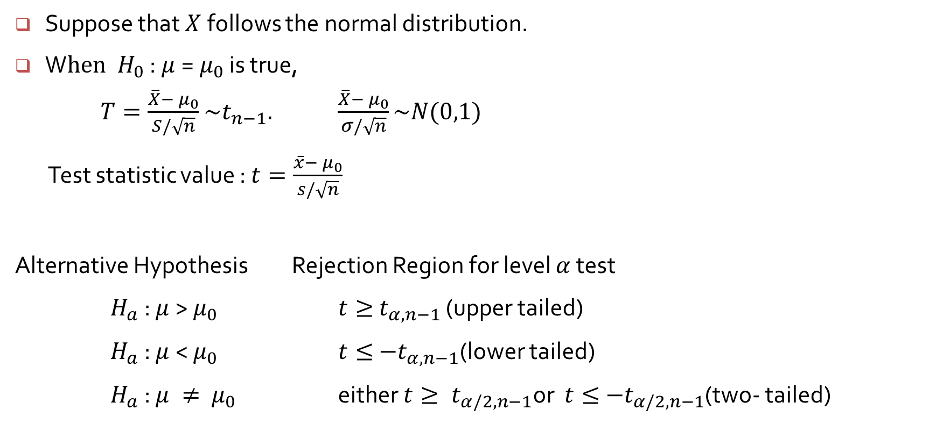
Test about a population mean with unknown $σ$ and Small Sample
Suppose that $X$follows the normal distribution.
W$hen H_{0}$ : $μ$=${ μ}_{0}$ is true,
$T=\frac{\overline{X}−{ μ}_{0}}{S/\sqrt{n}}$ $\sim t_{n−1}.$ $\frac{\overline{X}−{ μ}_{0}}{σ/\sqrt{n}}\sim N(0,1)$
Test statistic value : $t=\frac{\overline{x}−{ μ}_{0}}{s/\sqrt{n}}$
Alternative Hypothesis Rejection Region for level $α$ test
$H_{a}$ : $μ$> $μ_{0}$ $t≥{ t}_{α, n−1}$ (upper tailed)
$H_{a}$ : $μ$< $μ_{0}$ $t≤{ −t}_{α, n−1}$(lower tailed)
$H_{a}$ : $μ ≠ { μ}_{0}$ either $t≥{ t}_{α/2, n−1}\text{or}$ $t≤{ −t}_{α/2, n−1}$(two- tailed)

Slide 2
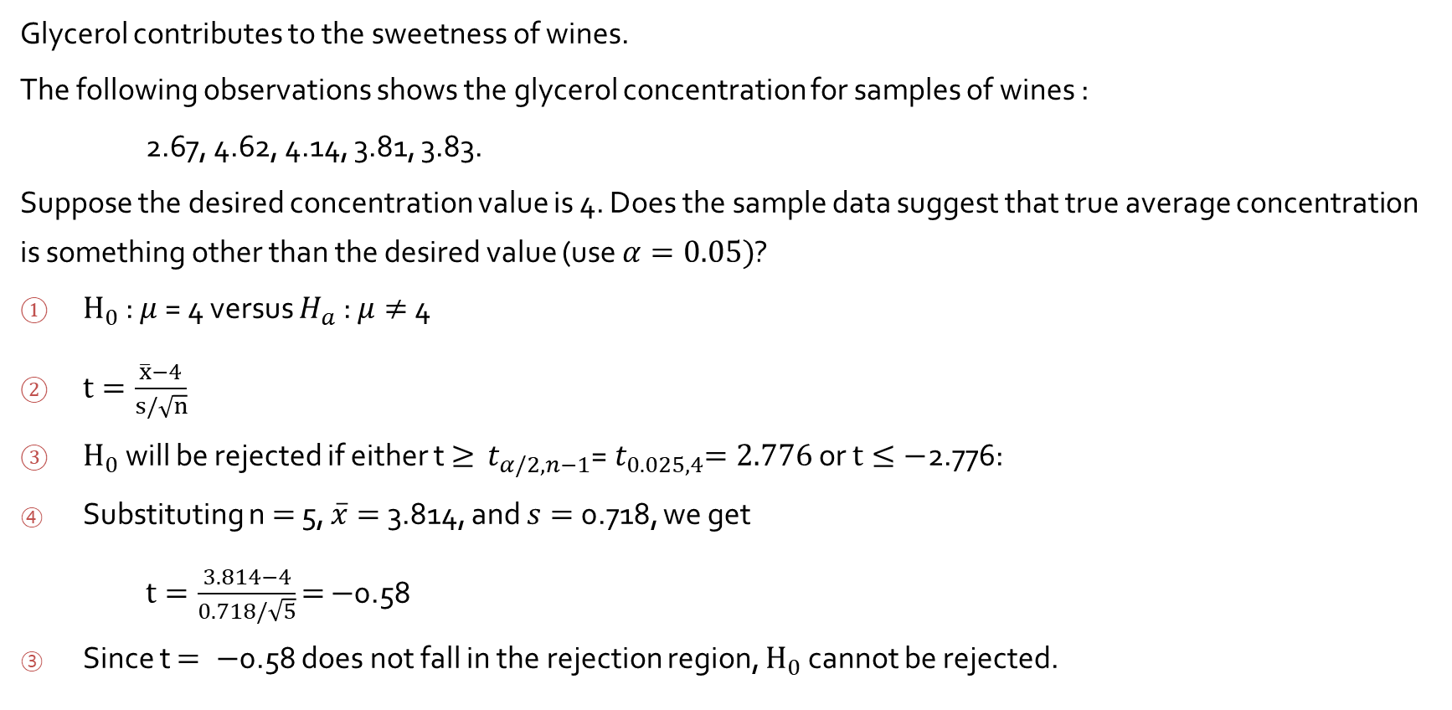
Example 8.9
Glycerol contributes to the sweetness of wines.
The following observations shows the glycerol concentration for samples of wines :
2.67, 4.62, 4.14, 3.81, 3.83.
Suppose the desired concentration value is 4. Does the sample data suggest that true average concentration is something other than the desired value (use $α=0.05)$?
$H_{0}$ : $μ$= 4 versus $H_{a}$ : $μ≠$4
$t=\frac{\overline{x}−4}{s/\sqrt{n}}$
$H_{0}$ will be rejected if either t $≥$ ${ t}_{α/2, n−1}$=${ t}_{0.025,4}=2.776$ or $t≤−$2.776:
Substituting n $=$ 5, $\overline{x}=$ 3.814, and $s=$ 0.718, we get
$t=\frac{3.814−4}{0.718/\sqrt{5}}$ $=$ $−$0.58
Since t $= −$0.58 does not fall in the rejection region, $H_{0}$ cannot be rejected.

Slide 3
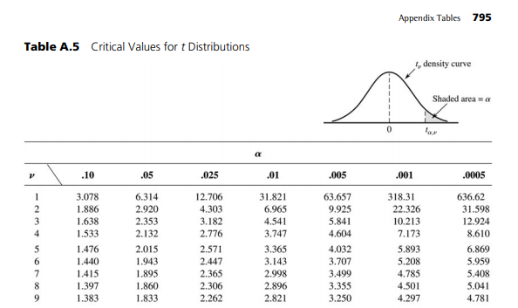

Slide 4
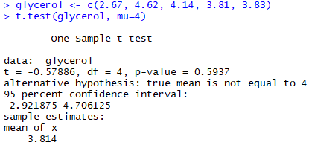
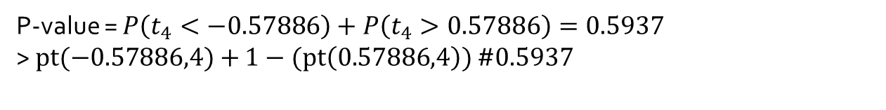
P-value = $P\left(t_{4}<−0.57886\right)+P\left(t_{4}>0.57886\right)=0.5937$
> $pt(−0.57886,4)+$ $1−(pt\left(0.57886,4\right))$ #$0.5937$

